Slide 1



Smart Contract Audit
Souhail MSSASSI

Slide 2
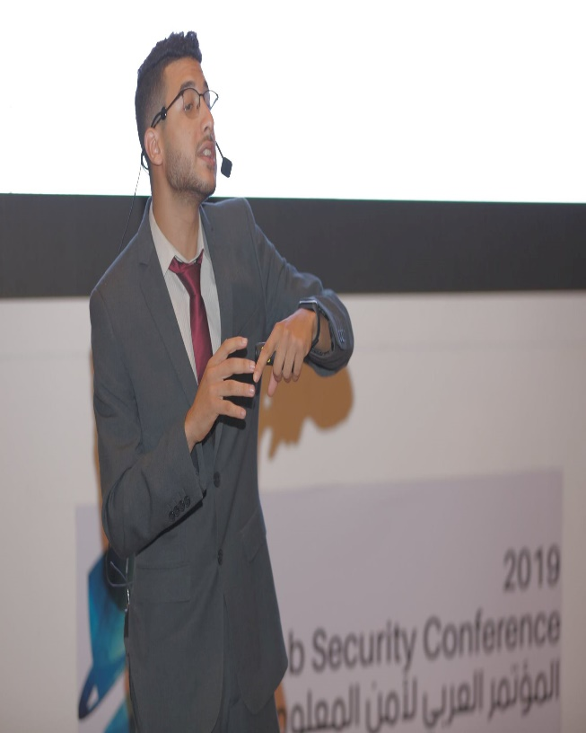
Who Am I
MSSASSI Souhail
Founder Of ShellBoxes
Security Consultant
Instructor at EatTheBlocks
OWASP Member
https://www.linkedin.com/in/mssassi/
https://fb.com/mssassii
souhail.mssassi@owasp.org

Slide 3

Agenda
Offensive Security in Smart Contracts
Audit Methodology
Detect Criticial EndPoints in Smart Contracts
The SWC Registry
Exploit Solidity Vulnerabilities
Tools

Slide 4
Offensive Security in Smart Contracts

Slide 5
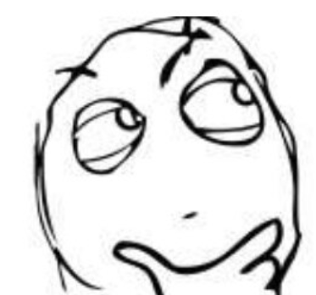
What is a Pentest

Slide 6
What is a Pentest
The process of evaluating systems, applications, smart contract, dAPPs with the intent of identifying vulnerabilities from the perspective of an unprivileged or anonymous user to determine potential impacts legally and under contract.

Slide 7
What is a Pentest
Try to Break into stuff before the bad guys do

Slide 8
What is the difference between a Pen Tester and a Hacker?
Pen Tester’s have prior approval from Senior Management
Hackers have prior approval from themselves.
Pen Tester’s social engineering attacks are there to raise awareness
Hackers social engineering attacks are there to trick the DMV into divulging sensitive information about the whereabouts of their estranged ex-spouse.

Slide 9
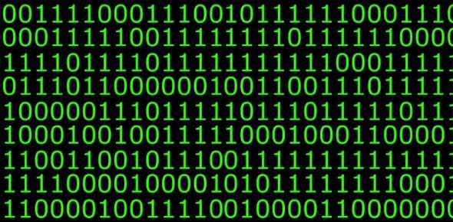
Types of Scan

Slide 10
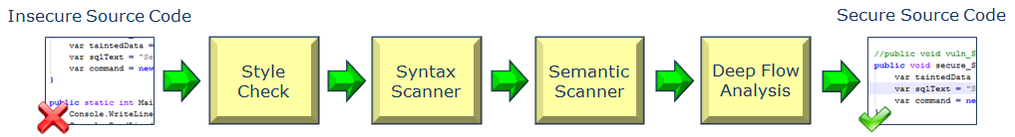
Static Analysis
Examining the code without running on a blockchain.
The static analysis must be done just after development and before dynamic analysis. The process provides an understanding of the code structure and can help to ensure that the code adheres to smart contracts standards.

Slide 11
Static Analysis
Advantages
Finds issues with the code before it is ready for integration and further dynamic testing.
It allows a quicker turnaround for fixes.
It can find weaknesses in the code at the exact location.
Limitations
Static analysis is not a complete security tool.
Only known attacks or predefined rules can be scanned.

Slide 12
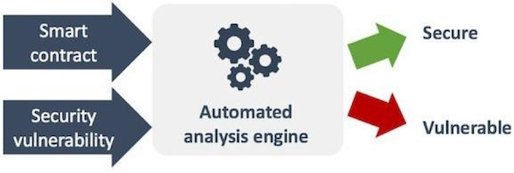
Dynamic Analysis
The process of testing smart contracts in a run-time environment, basically, a smart contract code deployed on blockchain and dummy values (boundary values) are taken as input according to the conditions of function.
Most of the dynamic analysis tools use symbolic analysis, fuzzers, formal verification to secure smart contract.

Slide 13
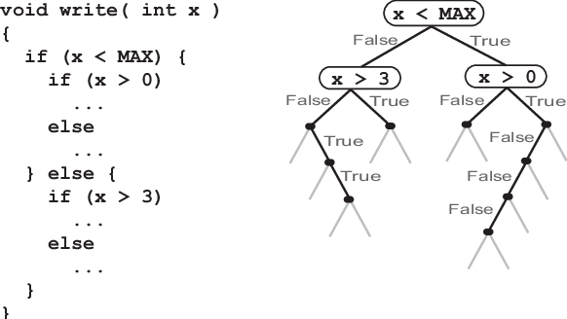
Symbolic Execution

Slide 14
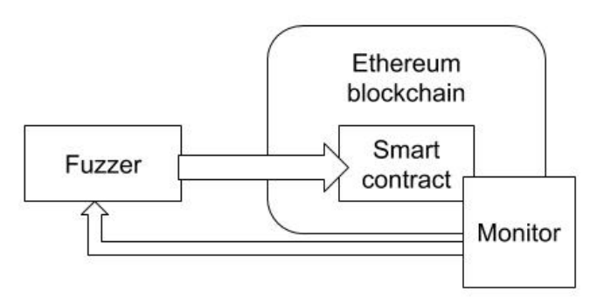
Fuzzing

Slide 15
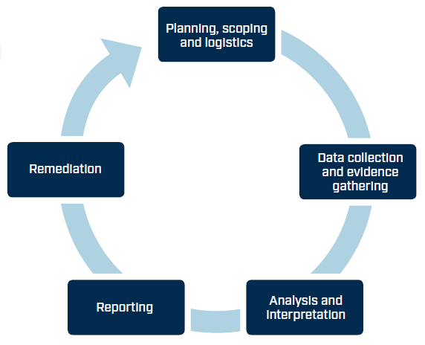
Audit Methodology

Slide 16

Black Box
Black box testing is a way to test a system with no access to information about the system being tested. The tester has no knowledge of the system, the source code, or the system architecture. Since this is the approach most attackers will take, black box testing replicates the method a hacker would use to try to get into the system.

Slide 17
Black Box
Advantages
It’s performed from an outsider’s perspective, not the system designer’s
It’s reproducible
It’s efficient on larger systems
Disadvantages
The tests are difficult to design
The results can be overestimated
It’s unable to test all software properties

Slide 18
Gray Box
Gray box testing combines elements of black box and white box testing. It simulates an attack by a hacker who has gained access to the network infrastructure documents. The tester has some knowledge of the system being tested, which is usually limited to design documents and architecture diagrams.

Slide 19
Gray Box
Advantages
Testing is performed from the user’s perspective, not the designer’s
There’s no need to provide internal information about the program’s operations and functions
Disadvantages
There’s limited ability to go over source code and test coverage
It can’t test every possible input stream due to time constraints

Slide 20
White Box
White box testing is also known as clear box testing, glass box testing, structural testing, and transparent box testing. This method of testing software checks the internal structure of an application. The tester has knowledge and access to the source code and the system architecture.

Slide 21
White Box
Advantages
It makes sure all independent paths of a module have been checked It verifies all logical decisions along with their values It checks syntax and uncovers typographical errors
Disadvantages
The testing is more difficult to design It requires specialized knowledge and tools.
It’s more expensive

Slide 22
Write a Report and Risk Assessment

Slide 23
Detect Criticial EndPoints in Smart Contracts

Slide 24
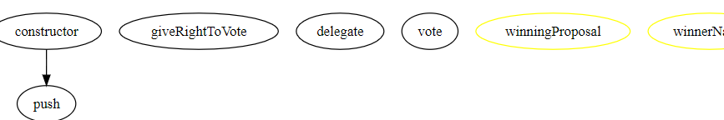
SolGraph

Slide 25
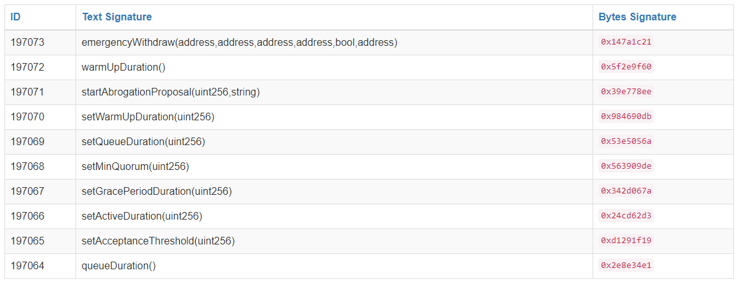
Critical Function Signature
Notes:
https://piyolab.github.io/playground/ethereum/getEncodedFunctionSignature/
https://www.4byte.directory/signatures/

Slide 26
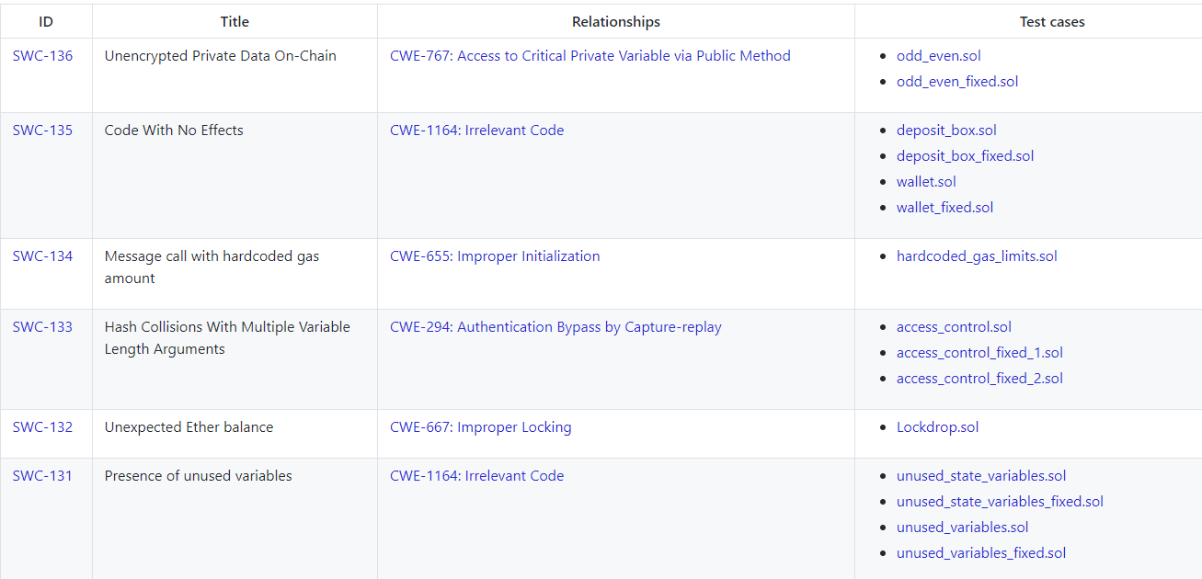
The SWC Registry

Slide 27
Exploit Solidity Vulnerabilities

Slide 28

Slither

Slide 29
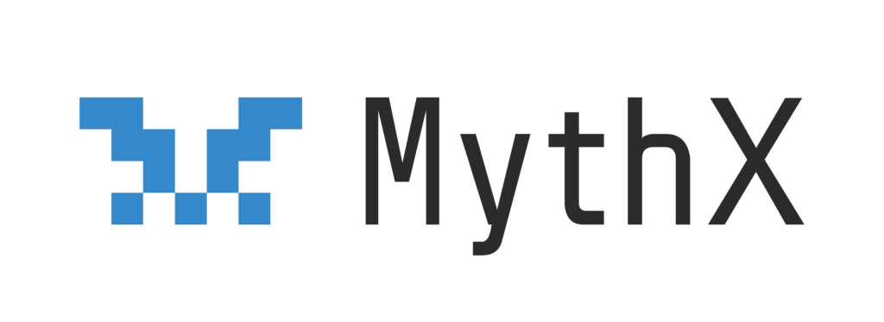
MythX

Slide 30
Questions ?
https://www.linkedin.com/in/mssassi/
https://fb.com/mssassii
souhail.mssassi@owasp.org

Slide 31
Thanks
https://www.linkedin.com/in/mssassi/
https://fb.com/mssassii
souhail.mssassi@owasp.org

